Slide 1


New Venture Creation
Tran Hoang Hai
School of Information and Communication Technology

Slide 2

New Venture Creation
New Venture Creation refers to the process of identifying a business opportunity, developing a business idea, and bringing it to life as a new business or entrepreneurial venture. It involves transforming an idea into a functioning organization that delivers goods or services and generates value for stakeholders. This process is central to entrepreneurship and often encompasses a range of activities and steps, from conceptualization to implementation.

Slide 3
“Business opportunities are like buses. There’s always another one coming.”
To leave graduate school with a detailed plan to establish, implement, and create a new venture, or to expand an existing one, or to learn how to make one.
To develop a specific business plan to improve or create your own entrepreneurial future.
To help develop an expanded entrepreneurial competence.
To think differently about your role as an entrepreneur and business leader.
Goals
Richard Branson

Slide 4
Schedule
Questions Before the Start-Up
What is a business plan?
Understand the definition, purpose, and components of a business plan.
Why a business plan?
Explore the importance of a business plan in guiding business strategy, securing funding, and setting objectives.
Experiences of various business plans
Learn from real-world examples of successful and unsuccessful business plans to understand best practices and pitfalls.
A workbook for writing a business plan
Utilize structured templates or guides to systematically create your own business plan.
Checklists for writing a business plan
Follow comprehensive checklists to ensure all critical elements of the business plan are covered.

Slide 5
Key Considerations for Starting a Business
Business Idea
A starting point, from which a business model can be created
Identify a foundation or idea that serves as the basis for developing a viable business model.
Knowledge needed on the subject matter
Gain expertise and understanding of the industry, market, or field related to the business.
Business skills needed (somewhat)
Acquire essential skills such as management, marketing, finance, and operations to run the business effectively.
Profitability – a key issue here!
Ensure the business is financially sustainable and focused on generating profits.
Customer needs and customer satisfaction!
Prioritize understanding and fulfilling customer needs while maintaining high levels of satisfaction

Slide 6
Sources and Approaches to Business Idea Generation
Business Idea
Own ability/knowledge/...
Leverage personal skills, expertise, and passions to create a unique business idea.
Imitation
Adapt or replicate existing successful business models while adding a unique value proposition.
R&D (Research and Development)
Invest in innovation and experimentation to develop new products or services.
Buying an idea or a company
Acquire an existing business or idea to jumpstart operations.
Systematic business idea generation
Use structured methods, brainstorming, or analytical tools to generate business ideas.
New technology (e.g., heart rate monitors)
Identify opportunities created by advancements in technology.

Slide 7
Sources and Approaches to Business Idea Generation
Business Idea
Changes in the environment (e.g., digital radio)
Respond to shifts in market trends, regulations, or industry landscapes.
New values and beliefs (e.g., ecology; green products)
Tap into evolving consumer preferences for sustainability and ethical practices.
Previous experiences (e.g., problems)
Draw on past challenges or insights to identify unmet needs or opportunities.
Customer problems
Focus on solving specific pain points or issues faced by customers.
Old demand and new technology (e.g., traffic signs)
Modernize traditional products or services with cutting-edge technology

Slide 8
Key Concepts and Pathways in Business Development
Business development
Invention → Innovation → Imitation (Schumpeter)
The cycle where new inventions lead to innovations, which are later imitated by others, driving economic and market evolution.
Research-based businesses, technology transfer
Businesses that emerge from academic or industrial research, often commercializing innovative findings through technology transfer.
New technology
The creation or adoption of cutting-edge tools, systems, or software to meet market demands and improve processes.
New applications
Developing innovative ways to use existing technologies or products in different markets or industries.
New services
Launching services tailored to emerging needs, such as cloud computing, digital marketing, or personal wellness programs.

Slide 9
Key Concepts and Pathways in Business Development
Business development
New demand
Identifying and addressing latent or emerging customer needs that are not currently met in the market.
Knowledge Intensive Business Services (KIBS)
Firms providing high-value services based on specialized knowledge, such as IT consulting, legal services, or R&D support.
Incubation services & financial assistance
Support systems like business incubators that provide startups with resources, mentorship, and funding to grow.
Pre start-up funding
Initial financial support to cover costs associated with starting a business, including prototyping and market research.
IPR rights (Intellectual Property Rights)
Securing legal protection for innovations, such as patents, trademarks, and copyrights, to ensure exclusivity and profitability.
eCommerce (eCom)
Leveraging online platforms to conduct business, from product sales to service delivery, capitalizing on the digital economy.

Slide 10
Group Assignment
Business development
Divide participants into groups of 4 people. Each group will work collaboratively to develop a business idea.
Select 3 industries or sectors using the Yellow Pages or any similar directory. The goal is to combine these sectors creatively to generate a unique business concept.
Brainstorming session: Groups will discuss and come up with a detailed business idea that connects the chosen industries. The idea should address a specific problem, highlight its uniqueness, and show potential for scalability.
Prepare a presentation: Each group will have 5 minutes to pitch their idea. The presentation should include:
The chosen industries/sectors
The business idea
The problem it solves
Its target audience and market potential
Group discussion: After all groups present, there will be a discussion to evaluate the ideas based on creativity, feasibility, and impact. Constructive feedback will be shared with each group.

Slide 11
Business idea: How to make money?
How to make Money
What are the strengths of the company?
Identify unique advantages such as expertise, innovation, resources, or market position.
Profitability:
Ensure the business model is sustainable and focused on generating consistent revenue and profits.
Products/Services:
Offer high-quality, innovative, or niche products/services that meet customer needs effectively.
Customers & Customer Orientation:
Understand the target audience and prioritize customer satisfaction and loyalty through excellent service and engagement.
Operative Decisions:
Make strategic operational choices that optimize efficiency, reduce costs, and improve delivery of products/services.
Alignment and Fit:
Ensure there is a coherent fit between the company's strengths, profitability, products/services, customer focus, and operational decisions for seamless execution and success.

Slide 12
Planning the Start-ups
Planning
1. Who do I work for?
Customer: Identify your target audience, understand their demographics, preferences, and behaviors.
Needs: Address specific pain points or gaps in the market by offering solutions that add value to customers’ lives.
Product: Develop high-quality, innovative, or tailored products/services that effectively meet customer needs.
4. How do I reach customers?
Channel: Utilize appropriate channels such as online platforms, retail stores, or direct sales to connect with and serve your audience.
2. What problems do I solve?
3. What do I work with?

Slide 13

Planning the Start-ups
Planning
1. Who do I work for?
Customer: Identify your target audience, understand their demographics, preferences, and behaviors.
Needs: Address specific pain points or gaps in the market by offering solutions that add value to customers’ lives.
Product: Develop high-quality, innovative, or tailored products/services that effectively meet customer needs.
4. How do I reach customers?
Channel: Utilize appropriate channels such as online platforms, retail stores, or direct sales to connect with and serve your audience.
2. What problems do I solve?
3. What do I work with?

Slide 14
Planning the Start-ups
Key Business Concepts
1. Business Model:
What is the basic principle behind the business? Define how your business creates, delivers, and captures value in the marketplace.
How do you plan to make money? Outline the strategy for generating revenue, including pricing structures and payment methods.
What are your sources of income? Identify streams such as product sales, subscriptions, licensing, or advertising.
How do you plan to create value? Articulate the unique benefits or solutions your product/service offers to customers.
What is the commercial proposition? Explain why customers should choose your business over competitors.
What is the customer going to pay for? Highlight the specific products, services, or experiences that address customer needs and justify the price.
2. Revenue Model:
3. Value Proposition:

Slide 15
Planning the Start-ups
Key Business Concepts – Example of IKEA
1. Business Model:
IKEA operates as a low-cost retail service provider, focusing on affordability and efficiency.
It offers self-service and flat-pack products to reduce costs and enhance customer convenience.
2. Revenue Model:
IKEA generates revenue by selling home furnishing items at retail prices directly to the public.
The model relies on high volume sales driven by its wide product range and competitive pricing.
3. Value Proposition:
Low-cost, easy-to-assemble items designed for modern living spaces.
A pleasant and engaging shopping experience, including inspirational showrooms and family-friendly services like in-store cafes.

Slide 16
Planning the Start-ups
Key Business Concepts – Example of Netflix
1. Business Model:
Netflix operates as a subscription-based streaming service provider, offering on-demand access to movies, TV shows, and original content.
It focuses on direct-to-consumer delivery via digital platforms.
2. Revenue Model:
Netflix generates revenue through monthly subscription fees at tiered pricing based on features like streaming quality and account sharing.
Additional revenue comes from licensing its original content to other platforms and merchandise tied to popular shows.
Provides convenient, ad-free, on-demand entertainment with a vast library of diverse content.
Offers personalized recommendations and a seamless user experience across multiple devices.
Regularly invests in high-quality original programming to maintain its competitive edge and attract global audiences.
3. Value Proposition:

Slide 17
Planning the Start-ups
Key Business Concepts – Example of Tableau
1. Business Model:
Tableau operates as a data visualization and analytics platform, enabling users to transform raw data into actionable insights.
It offers a software-as-a-service (SaaS) model alongside perpetual licensing options for enterprises.
2. Revenue Model:
Revenue is generated through subscription plans (monthly or annual) for individual users, teams, and enterprises.
Additional income streams include training services, consulting, and custom integrations for large organizations.
3. Value Proposition:
Provides intuitive and interactive tools to create visually engaging dashboards and reports without requiring deep technical expertise.
Offers real-time data connectivity and integration with various data sources, ensuring flexibility for users.
Supports AI-driven insights with features like automated data prep, predictive analytics, and natural language processing (NLP) for query handling.

Slide 18
Planning the Start-ups
Key Business Concepts – Example of DataRobot
1Business Model:
DataRobot operates as an AI-driven platform for automated machine learning (AutoML), enabling businesses to build, deploy, and manage AI models efficiently.
Targets SMEs and enterprises across industries like finance, healthcare, and retail by providing easy-to-use AI solutions.
2. Revenue Model:
Subscription plans: Offers tiered pricing based on features and user capacity, making it accessible to businesses of all sizes.
Professional services: Provides consulting, custom AI model development, and training for companies integrating AI into their workflows.
Partnerships: Collaborates with cloud service providers and software integrators to enhance reach and functionality.
3. Value Proposition:
Delivers automated AI model development, allowing businesses to harness the power of AI without requiring a team of data scientists.
Provides end-to-end AI lifecycle management, from data preparation to deployment, making AI adoption seamless.
Ensures scalability and adaptability, enabling businesses to optimize processes and improve decision-making with minimal overhead.

Slide 19
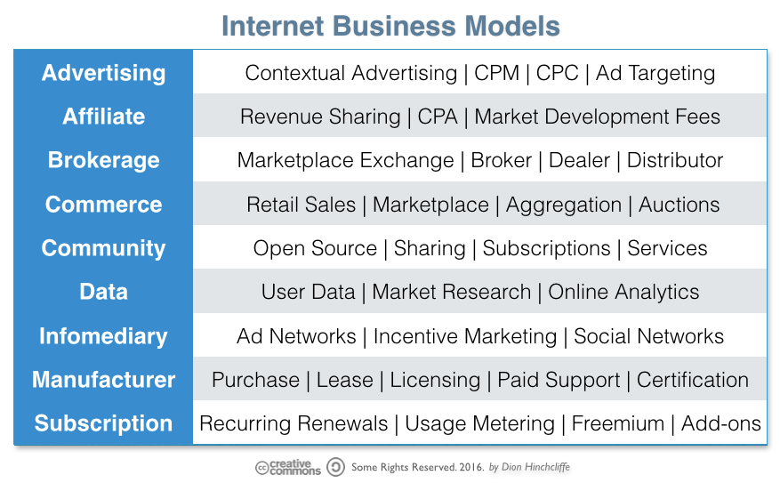
New Business Models
New Business Models
Origins:
Discussions on new business models gained momentum during the Dot.com hype, emphasizing innovative ways to leverage internet-based opportunities.
Definition:
A business model defines a company’s activities and goals, outlining how it aims to take advantage of emerging business opportunities.
Focus on Customer Base:
Building and expanding a customer base is often a primary goal of new business models, especially in digital and startup ecosystems.
Importance of Marketing:
Marketing activities play a critical role in attracting and retaining customers, ensuring the success of new business ventures.

Slide 20
New Business Models
Business Models
The Open Business Model:
Description: Leverages collaboration and shared innovation, often involving open-source systems or platforms.
Examples:
Amazon: An open marketplace for third-party sellers to reach customers.
Open Innovation: Companies like Tesla sharing patents to promote electric vehicle adoption.
OSS (Open Source Software): Linux and GitHub platforms.
The Subscription Business Model:
Description: Generates recurring revenue by providing ongoing access to products or services.
Examples:
Magazines: The New Yorker.
E-Services: Netflix, Spotify.
Podcasts: Patreon-supported content.

Slide 21
New Business Models
Business Models
The Razor and Blades Business Model (Bait & Hook):
Description: Sells a base product (razor) at a low cost while generating profit from related consumables (blades).
Examples:
Nintendo Wii: Affordable consoles with revenue from games and accessories.
Printers: Cheap printers with expensive ink cartridges.
The Pyramid Scheme Business Model:
Description: Relies on recruitment of participants, where lower levels provide value or payments to upper levels.
Examples: Often illegal schemes disguised as investment opportunities.
The Multi-Level Marketing (MLM) Business Model:
Description: Involves recruiting individuals who sell products and recruit others, earning commissions from their sales.
Examples:
Herbalife, Amway, Avon.

Slide 22
New Business Models
Business Models
The Network Effects Business Model:
Description: Gains value as more users join, increasing utility for all.
Examples:
Mobile Phones: Networks are more valuable with more users.
Social Media: Facebook, LinkedIn.
The Monopolistic Business Model:
Description: Dominates a market with little or no competition.
Examples:
ALKO: Alcohol monopoly in Finland.
Systembolaget: Alcohol monopoly in Sweden.
The Cutting Out the Middleman Model:
Description: Direct-to-consumer sales, eliminating intermediaries to reduce costs.
Examples:
Dell: Direct sales of computers to customers.
Warby Parker: Online eyewear sales.

Slide 23
New Business Models
Business Models
The Auction Business Model (Traditional):
Description: Involves competitive bidding where the highest bidder wins the product or service.
Examples:
Traditional auctions: Sotheby’s, Christie’s for art, antiques, and collectibles.
The Online Auction Business Model:
Description: Digital platforms facilitate auctions where users can bid on items.
Examples:
eBay, huuto.net, Craigslist (auction-based listings).
The Bricks and Clicks Business Model:
Description: Combines physical retail stores (bricks) with online platforms (clicks) for an omnichannel approach.
Examples:
Walmart, Best Buy, IKEA.

Slide 24
New Business Models
Business Models
The Loyalty Business Models (Relationship Marketing):
Description: Focuses on building long-term customer relationships through loyalty programs and personalized marketing.
Examples:
Starbucks Rewards, Amazon Prime, airline frequent flyer programs.
The Collective Business Models:
Description: Operates through cooperative ownership or collective participation, sharing benefits and responsibilities.
Examples:
Co-operatives: Mondragon (worker-owned), Credit Unions.
Trade Associations: National Retail Federation.
The Industrialization of Services Business Model:
Description: Applies mass-production techniques to services for efficiency and consistency.
Examples:
McDonald’s, Subway, Domino’s Pizza.

Slide 25
New Business Models
Business Models
The Low-Cost Carrier Business Model:
Description: Focuses on offering basic services at a lower cost by minimizing operational expenses and upselling add-ons.
Examples:
Ryanair, Blue1, EasyJet.
The Online Content Business Model:
Description: Monetizes digital content such as music, videos, and information through direct sales, upgrades, or subscriptions.
Examples:
Apple iPod/iTunes: Selling individual songs and upgrades.
Netflix: Streaming content on subscription.
The Freemium Business Model:
Description: Offers basic services for free, with premium features or functionalities available at a cost.
Examples:
Skype: Free calls with paid features for international or group calls.
Spotify Open: Free streaming with ads, premium for ad-free and offline listening.
The Premium Business Model:
Description: Focuses on high-quality, luxury products with superior branding and exclusivity.
Examples:
Ferrari, Rolex, Gucci.

Slide 26
New Business Models
Business Models
The Direct Sales Model:
Description: Bypasses intermediaries to sell directly to consumers through personal communication or online platforms.
Examples:
Avon, Tupperware, telemarketing companies.
The Professional Open-Source Model:
Description: Provides free software and generates revenue through consulting, support, and custom solutions.
Examples:
Red Hat: Free Linux distribution with paid enterprise support.
MongoDB: Open-source database with professional services.
Various Distribution Business Models:
Description: Determines how a product/service reaches customers through channels like retail, online, or direct.
Examples:
Retail: Walmart, Amazon.
Online platforms: Etsy, Shopify.
Subscription services: Blue Apron, Dollar Shave Club.

Slide 27
Business model canvas

Slide 28
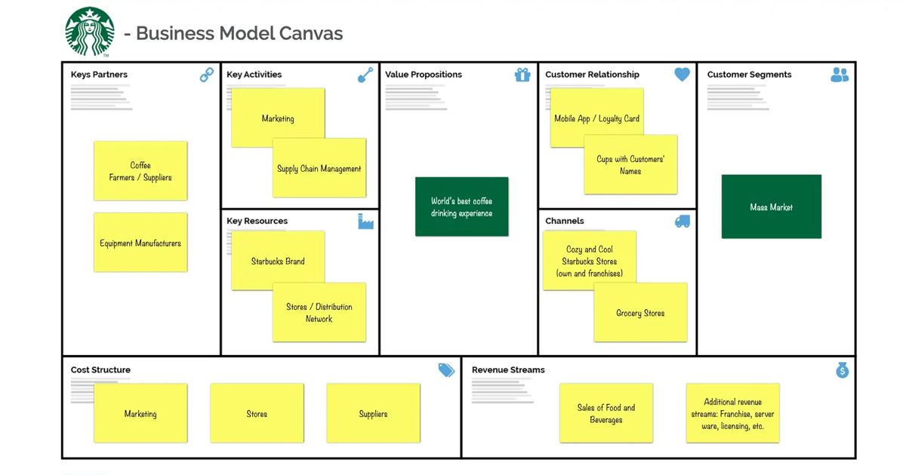
Business model canvas

Slide 29
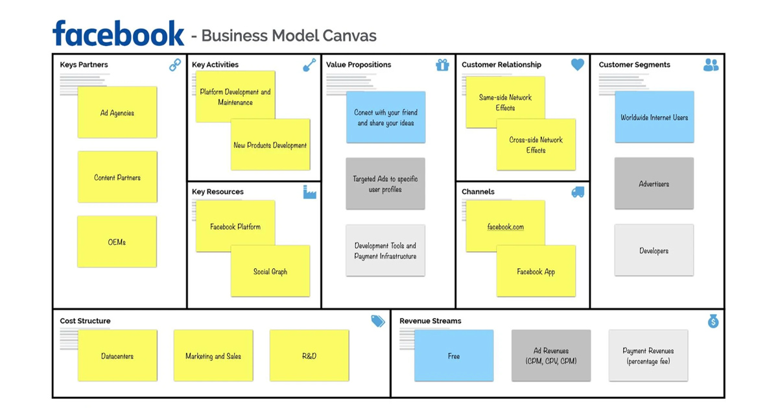
Business model canvas

Slide 30
Key Considerations for Market Demand Analysis
Demand analysis
Customer Need:
Identify the specific requirement or problem that needs to be addressed for successful marketing.
Understand what customers value most in products or services to ensure alignment with their expectations.
Substitutes:
Analyze existing alternative products or services that customers might choose instead.
Determine how your offering is superior or more appealing compared to substitutes.
Customer Behavior:
Evaluate if customers need to change their habits or consumption patterns to use your product/service.
Understand that requiring significant behavior changes is challenging and may affect adoption rates.
Demand Consistency:
Assess whether demand is steady or fluctuates due to factors like seasons, holidays, or economic conditions.
Plan strategies for handling variability in demand, such as promotions or diversifying offerings.
External Influences:
Consider potential changes in infrastructure, legislation, or local dynamics that could impact demand.
Stay informed about trends and regulatory shifts to adapt your strategies accordingly.

Slide 31
Key Considerations for Customer Segmentation
Customer segment
Who Are My Customers?
Define customer demographics:
Location: Urban, suburban, rural, or specific regions.
Age: Target age range (e.g., teenagers, millennials, retirees).
Gender: Male, female, non-binary, or inclusive of all.
Occupation: Professions or industries relevant to your product/service.
Annual Income: Socioeconomic groups that can afford and value your offering.
Personality and Lifestyle: Interests, hobbies, and buying habits.
How Do I Reach My Customers?
Utilize an effective marketing mix:
Advertising: Social media, TV, print, or digital ads.
Distribution channels: Online platforms, physical stores, or both.
Engagement: Email campaigns, influencer partnerships, or in-person events.

Slide 32
Key Considerations for Customer Segmentation
Customer segment
How Do My Customers Consume at the Moment?
Understand current consumption patterns:
Online shopping or in-store purchasing.
Preferences for delivery, subscription models, or one-time purchases.
Who Makes Buying Decisions?
Identify decision-makers and influencers:
Individuals, families, or businesses.
Consider influencers like parents, peers, or corporate stakeholders.
Competitive Products/Services:
Analyze competing offerings:
Understand their strengths, weaknesses, and pricing.
Identify gaps or unmet needs your product/service can fill.

Slide 33
Competitive Analysis Framework
Customer segment
Who Are My Competitors?
Identify both direct competitors (offering similar products/services) and indirect competitors (meeting similar customer needs differently).
Categorize competitors based on size, market share, and geographic presence.
What Are the Strengths and Weaknesses of Your Competitors?
Strengths:
Strong brand reputation.
Wide distribution network.
Advanced technology or unique offerings.
Weaknesses:
Poor customer service.
High prices.
Limited product range or outdated systems.
What Are Their Ways to Compete?
Analyze strategies such as:
Price wars (low-cost leadership).
Differentiation (unique features or quality).
Customer loyalty programs.
Aggressive marketing campaigns.

Slide 34
Competitive Analysis Framework
Customer segment
Who Is on the Rise/Fall?
Track market trends to identify emerging competitors gaining market share.
Spot declining competitors struggling with outdated business models or poor adaptability.
How Do They Do Their Marketing?
Study their marketing channels:
Social media, search engine ads, partnerships, or events.
Branding and messaging strategies (tone, focus, appeal).
Potential New Competitors?
Anticipate entrants from:
Adjacent industries diversifying into your space.
Startups with disruptive innovations.
Global players entering your local market.
How Do I Succeed in Competition with My Competitors?
Focus on your unique value proposition.
Build customer loyalty with exceptional service and engagement.
Innovate consistently to stay ahead of trends.
Optimize pricing and cost-efficiency.
Leverage data-driven marketing to target the right audience effectively.

Slide 35
Market Segment and Production/Service Strategy
Market segment
How Do We Take Care of Production/Service Providing?
Quality Assurance: Ensure consistent quality of products/services through robust processes and regular audits.
Efficiency: Optimize production or service delivery using lean methodologies or automation.
Flexibility: Adapt production/service capacity to meet changing demand.
Sustainability: Incorporate eco-friendly practices to align with market expectations.
How Do We Reach the Customers?
Marketing Channels: Use a mix of online (social media, email marketing) and offline (events, print ads) channels.
Direct Engagement: Build relationships through customer support, loyalty programs, or personalized offers.
Partnerships: Collaborate with other brands or platforms for wider reach.
Make or Buy Decisions?
Make:
Suitable when quality control and proprietary knowledge are critical.
Offers greater customization and potential cost savings over time.
Buy:
Consider outsourcing if external providers are cost-efficient or offer specialized expertise.
Ideal for non-core components or services.
Channel Decisions?
Direct Channels: Sell directly to customers through e-commerce, physical stores, or mobile apps.
Indirect Channels: Use distributors, retailers, or third-party platforms for broader market access.
Omnichannel Approach: Combine online and offline channels to offer seamless customer experiences.

Slide 36
Building and Maintaining Company Image
Company image
How Do the Customers See Us?
Perceived Value: Customers evaluate the brand based on product/service quality, reliability, and trustworthiness.
Reputation: Established through customer reviews, testimonials, and market presence.
Brand Personality: The emotional connection customers feel towards the company (e.g., friendly, innovative, luxurious).
Starting Business – No Image:
New businesses must focus on:
Creating visibility through marketing and networking.
Delivering consistent quality to build initial trust.
Defining core values that align with target audience expectations.
Describing the Company by Adjectives:
Choose adjectives that reflect the desired brand identity:
Innovative: Cutting-edge, forward-thinking, creative.
Reliable: Dependable, consistent, trustworthy.
Customer-focused: Attentive, empathetic, service-oriented.
Dynamic: Agile, adaptable, energetic.
Sustainable: Eco-friendly, responsible, ethical.

Slide 37
Understanding Demand
Demand
What Are the Forces Behind Demand?
Customer needs and preferences: Shifts in lifestyle, trends, or pain points.
Economic factors: Disposable income, employment rates, and purchasing power.
Technological advancements: Innovation driving new product or service demands.
Social and cultural influences: Changing values and societal norms.
How Big Is the Demand in Your Line of Business?
Conduct market research to measure the total addressable market (TAM) and identify potential customer base size.
Assess whether the industry is growing, stable, or declining.
Is There More Demand Than Supply?
Excess demand: Opportunities for growth, but may face competition.
Excess supply: Requires differentiation or niche targeting to stand out.

Slide 38
Understanding Demand
Demand
Changes in Demand in the Near Future?
Analyze trends, innovations, or external factors (e.g., regulatory changes, economic shifts).
Stay flexible to adapt offerings as demand evolves.
Substitutes?
Identify existing alternatives that fulfill similar customer needs.
Highlight your unique value proposition to make your product/service more attractive.
What Kind of Market Share Are You After?
Define realistic goals:
Niche market: Focus on a specific customer segment with tailored offerings.
Broad market: Compete for a larger audience by addressing widespread needs.
Set measurable objectives for market entry and growth.

Slide 39
Market Intelligence
Market Intelligence
From Where to Get Market Information?
Industry Reports: Published by firms like Gartner, IBISWorld, or Statista.
Government Data: Economic reports, trade statistics, and census data.
Trade Associations: Insights from industry-specific organizations.
Market Research Firms: Custom studies and surveys.
News and Media: Industry trends reported by reputable outlets.
From Where to Get Competitor Information?
Company Websites: Product offerings, pricing, and marketing strategies.
Financial Reports: Public filings for listed companies.
Social Media: Monitoring competitor activities and customer engagement.
Customer Reviews: Feedback on competitor products/services.
Third-Party Tools: Tools like SEMrush or SimilarWeb for web traffic and SEO analysis.

Slide 40
Market Intelligence
Market Intelligence
From Where to Get Customer Information?
Surveys and Questionnaires: Direct feedback from target audiences.
Customer Relationship Management (CRM): Analyze existing customer data.
Social Media Analytics: Understand customer preferences and behaviors.
Focus Groups: Conduct small group discussions for deeper insights.
Online Forums and Communities: Discover customer pain points and desires.
From Where to Get Other Needed Information?
Academic Journals: Research papers for technical or specialized knowledge.
Business Consultants: Expert insights tailored to specific needs.
Conferences and Trade Shows: Networking and trend updates.
Patents and IP Databases: Insights into new innovations.
Regulatory Authorities: Information on legal and compliance requirements.

Slide 41
Selecting Sector and Revenue Logic
Selecting Sector and Revenue Logic
Key Considerations:
Make no assumptions: Competition exists in every market.
Evaluate sector dynamics: Understand the competitive landscape, growth potential, and barriers to entry.
Difficult Sectors:
Old sectors: Saturated industries with minimal innovation.
Dominated by large companies: Hard to compete against established giants with significant resources.
Long-term relationships: Customers are loyal to existing suppliers, making market penetration challenging.
Sector is not growing: Limited opportunities for new entrants or innovation.
Easier Sectors:
New: Emerging industries with high demand for innovative products/services.
Small business dominated: Less competition from large, resource-heavy companies.
Local: Opportunities to cater to regional needs and build relationships.
Growing sectors: High growth industries with expanding market opportunities (e.g., green energy, AI, e-commerce).

Slide 42
The Shifting Paradigm for Organizational Success
Old Success Factors
Old Success Factors:
Size:
Larger organizations were often seen as more successful due to economies of scale and extensive resources.
Role Clarity:
Clear and rigidly defined roles ensured operational efficiency and reduced ambiguity.
Specialization:
Dividing tasks into specialized units allowed for higher productivity and expertise.
Control:
Centralized decision-making and strict oversight ensured consistency and minimized risks.

Slide 43
The Shifting Paradigm for Organizational Success
New Success Factors
New Success Factors:
Speed:
Quick decision-making and faster time-to-market are crucial in dynamic industries.
Flexibility:
Adaptability to changing market conditions and customer needs is essential for resilience.
Integration:
Seamless collaboration across teams and technologies fosters better outcomes.
Innovation:
Continuous improvement and breakthrough ideas are key to staying competitive in a rapidly evolving world.

Slide 44
Nuts and Bolts of Starting a Business
Nuts and Bolts of Starting a Business
Preliminary Business Plan:
Draft a detailed plan outlining the business idea, target market, competitive analysis, financial projections, and operational strategy.
Organizing Financing:
Determine funding needs and secure capital through savings, loans, investors, or crowdfunding.
Selection of Legal Form of the Business:
Choose the appropriate business structure (e.g., sole proprietorship, partnership, LLC, corporation) based on liability, taxation, and operational needs.
Licensing Requirements:
Verify whether the business needs specific licenses or permits to operate legally in the chosen sector and location.

Slide 45
Nuts and Bolts of Starting a Business
Nuts and Bolts of Starting a Business
Starting Announcement to Company Register:
Register the business with the local or national company registrar to obtain legal recognition.
Starting Announcement to the Tax Authorities:
Inform tax authorities and register for tax purposes (e.g., VAT, income tax, corporate tax).
Insurances:
Acquire necessary insurance policies, such as liability insurance, property insurance, or employee coverage, to mitigate risks.
Organizing Bookkeeping and Auditors:
Set up a system for accounting and financial management.
Appoint auditors if required by law or for internal governance.

Slide 46


Summary
New Venture Creation is the process of transforming a business idea into a functioning enterprise. It involves identifying opportunities, developing a business concept, and addressing customer needs with innovative solutions. Key steps include creating a business plan, organizing resources, securing funding, and ensuring legal and operational readiness. Success depends on understanding market demand, building a solid value proposition, and adapting to challenges with creativity, flexibility, and strategic planning. This process drives innovation, economic growth, and personal development.
Top 50 Companies Slogan - Tagline
Elon Musk 5 Rules for creating company

Slide 47




Thank you
Tran Hoang Hai
haith@soict.hust.edu.vn

